Slide 1
PHR Intelligent User Interface
Buthaina Aldosary
Hardev Goraya
Ronak Patel
Nov 21, 2013

Slide 2
Introduction
Context
Hospital.
Highly interruptible workplace.
Interactive and contingent nature.
Good communication is a must.
Error prone environment.

Slide 3
Introduction
Target Users
Nurses and doctors
Advanced level of literacy.
Time and productivity driven.

Slide 4


User Interface Adaptation
Prior knowledge that patients being treated will most likely have abnormal values for the vital signs.
For two consecutive measures, if the trend indicates a more “healthy”, “non-healthy” state, an appropriate message will appear indicating this.
If the measures are stable (no change), then no message will appear.
Better, “more healthy” state.
39 °C
37 °C

Slide 5
Summarization of Vital Sign Values
Measurement | Interpretation
Blood Pressure | Low Blood Pressure (hypotension): Systolic (top number) <=90, Diastolic (bottom number) <=60. BPM<60 Normal Blood Pressure: Systolic (top number) <=120 Diastolic (bottom number) <=80. BPM=[60,100] High Blood Pressure (hypertension): Systolic (top number) =(140, 190], Diastolic (bottom number) =(90,100]. BPM>100
O2 Saturation | Any reading < 90% leads to life threatening complications.
Temperature | Hypothermia: <= 35.0 °C. Hyperthermia: >= 40°C. Normal: = (35,37.2] °C.
Blood Sugar | Excellent: [50,115] mg/dl Good: (115,180] mg/dl - Poor: (180,380] mg/dl

Slide 6
Decision Tables
Blood Pressure
 | Conditions | Rules
 |  | 1 | 2 | 3 | 4 | 5 | 6
C1 | Previous Reading = Low | Y |  | Y
C2 | Previous Reading = Normal |  | Y |  | Y
C3 | Previous Reading = High |  |  |  |  | Y | Y
C4 | Current Reading = Low |  | Y |  |  |  | Y
C5 | Current Reading = Normal | Y |  |  |  | Y
C6 | Current Reading = High |  |  | Y | Y
 | Actions
A1 | Alert: Healthy | X |  |  |  | X
A2 | Alert: Warning Bad |  | X | X | X |  | X

Slide 7
Decision Tables
O2 Saturation
 | Conditions | Rules
 |  | 1 | 2
C1 | Previous<90 % | Y
C2 | Previous >= 90% |  | Y
C3 | Current <90 % |  | Y
C4 | Current >= 90% | Y
 | Actions
A1 | Healthy | X
A2 | Warning-Bad |  | X

Slide 8
Decision Tables
Blood Sugar
 | Conditions | Rules
 |  | 1 | 2 | 3 | 4
C1 | Previous= (180,380] mg/dl | Y
C2 | Previous= (115,180] mg/dl |  | Y |  | Y
C3 | Previous= [50,115] mg/dl |  |  | Y
C4 | Current=(180,380] mg/dl |  |  |  | Y
C5 | Current= (115,180] mg/dl | Y |  | Y
C6 | Current= [50,115] mg/dl |  | Y
 | Actions
A1 | Healthy-Better | X
A2 | Healthy-Best |  | X
A3 | Healthy |  |  | X
A4 | Warning-Bad |  |  |  | X

Slide 9
Decision Tables
Temperature
 | Conditions | Rules
 |  | 1 | 2 | 3 | 4
C1 | Previous = 35.0 °C. | Y
C2 | Previous =(35,37.2] °C. |  | Y |  | Y
C3 | Previous >= 40°C. |  |  | Y
C4 | Current = 35.0 °C. |  |  |  | Y
C5 | Current=(35,37.2] °C. | Y |  | Y
C6 | Current >= 40°C. |  | Y
 | Actions
A1 | Healthy | X |  | X
A2 | Warning-Bad |  | X |  | X

Slide 10
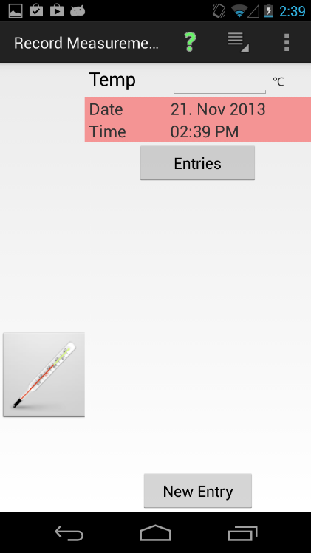
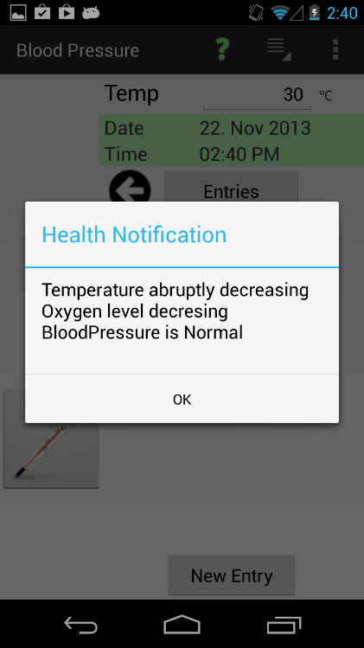
Implemented Intelligence
Record Temperature
Alert Message!

Slide 11
Testing
Blood Pressure
 |  | BPM | Systolic | Diastolic | Interpretation | Status
Test Case 1 | Prev | 30 | 60 | 30 | Increase | Pass
 | Current | 60 | 105 | 50
Test Case 2 | Prev | 100 | 120 | 80 | Decrease | Pass
 | Current | 50 | 90 | 60
Test Case 3 | Prev | 50 | 80 | 50 | Increase | Pass
 | Current | 110 | 150 | 91
Test Case 4 | Prev | 100 | 120 | 80 | Increase | Pass
 | Current | 119 | 180 | 99
Test Case 5 | Prev | 119 | 180 | 99 | Decrease | Pass
 | Current | 100 | 120 | 80
Test Case 6 | Prev | 119 | 180 | 99 | Decrease | Pass
 | Current | 50 | 80 | 50

Slide 12
Testing
O2 Saturation
 |  | % | Interpretation | Status
Test Case 1 | Prev | 80 | Increase | Pass
 | Current | 95
Test Case 2 | Prev | 98 | Decrease | Pass
 | Current | 60

Slide 13
Testing
Temperature
 |  | °C. | Interpretation | Status
Test Case 1 | Prev | 30 | Increase | Pass
 | Current | 36
Test Case 2 | Prev | 36.5 | Increase | Pass
 | Current | 40
Test Case 3 | Prev | 45 | Decrease | Pass
 | Current | 37
Test Case 4 | Prev | 37 | Decrease | Pass
 | Current | 34
Test Case 5 | Prev | 30 | Increase | Pass
 | Current | 40
Test Case 6 | Prev | 45 | Decrease | Pass
 | Current | 30

Slide 14
Testing
Blood Sugar
 |  | Mg/dl | Interpretation | Status
Test Case 1 | Prev | 185 | Increase | Pass
 | Current | 120
Test Case 2 | Prev | 140 | Increase | Pass
 | Current | 70
Test Case 3 | Prev | 210 | Increase | Pass
 | Current | 110
Test Case 4 | Prev | 115 | Decrease | Pass
 | Current | 165
Test Case 5 | Prev | 120 | Decrease | Pass
 | Current | 380
Test Case 6 | Prev | 90 | Decrease | Pass
 | Current | 370

Slide 15
Limitations/Issues
Initially, we included the weight to be part of the adaptations we will implement.
Gender/ Height are required for weight calculations.
Current version of PHR does not store these values.
Weight adaptation has been excluded.

